Slide 1

Blinkit Operations, Fulfillment & Marketing Analytics Dashboard
An end-to-end data analytics pipeline — SQL, Python (Pandas, NumPy), DAX, and Power BI — transforming raw operational data into a 3-page executive dashboard for supply chain, fulfillment, and customer growth insights.
DATA ANALYST: ANSHUL SHRIVASTAVA
JULY 2026

Slide 2

Project Overview
This project synthesizes multi-departmental Blinkit data — customer demographics, delivery, inventory, feedback, and marketing — into actionable business intelligence. Quick-commerce operates on razor-thin margins and high customer expectations for rapid delivery.
Logistics Bottlenecks
Identify driver delays across delivery distances
Inventory Damage
Track stock health and minimize transit loss
Customer Satisfaction
Assess ratings across service touchpoints
Marketing ROAS
Evaluate campaign efficiency and budget allocation

Slide 3
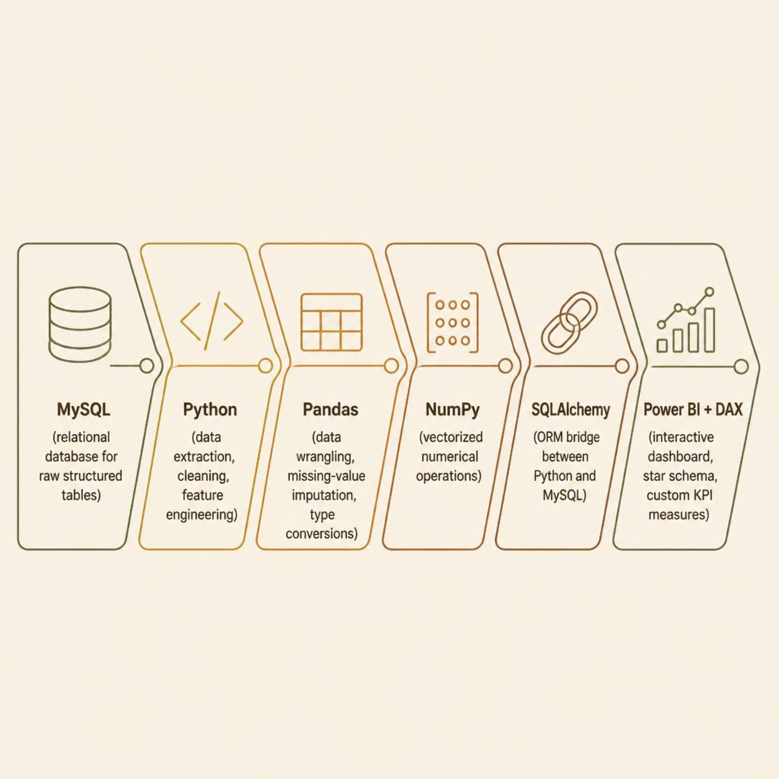
Tech Stack & Architecture
Why This Stack?
Each tool was selected for its functional advantage in the end-to-end workflow — from raw data ingestion to executive visual storytelling.
MySQL: ACID-compliant relational database with efficient indexing
Python (Pandas, NumPy): Automated cleaning, feature engineering, and type casting
SQLAlchemy: Seamless ORM bridge between Python and MySQL
Power BI + DAX: Interactive dashboard with dynamic KPI measures

Slide 4

Dataset Overview
Six interconnected tables form the analytical backbone, connected via a Star Schema with transformed_orders as the central fact table.
Table
Rows
Key Columns
Customers
1,000
customer_id, segment, location
Orders
5,000
order_id, total_amount, status
Delivery
5,000
distance_km, delay_minutes
Inventory
1,200
damaged_stock, damage_rate
Feedback
4,200
rating, feedback_category
Marketing
150
spend, revenue_generated, roas
Missing delay_minutes (~3.2%) = on-time orders. Missing feedback_category (~8.5%) = optional rating fields.

Slide 5

Data Cleaning & Transformation
Deduplicate
Impute Missing
Standardize Time
Feature Engineer
All transformed DataFrames were exported back to MySQL and saved as optimized CSVs for Power BI star-schema modeling. Key engineered features include delay_minutes, is_delayed boolean flag, and temporal fields (order_year, order_month, order_day_of_week, order_hour) for time-series analysis.

Slide 6

Key Business Findings
Distance-Delay Spike
Orders beyond 4 km surge to 18.5% delay rate (avg 14.1 min) vs. under 4% within 3 km.
Satisfaction Collapse
Ratings hold at 4.1–4.6/5.0 under 5-min delays but collapse to 2.1/5.0 past 10 minutes.
Cold-Chain Vulnerability
Fresh Produce & Dairy account for 62% of all damage at 5.8% rate vs. 1.9% platform average.
Marketing Misallocation
Search & In-App Ads yield 4.2× and 3.8× ROAS; broad Social Media lags at 1.4×.

Slide 7
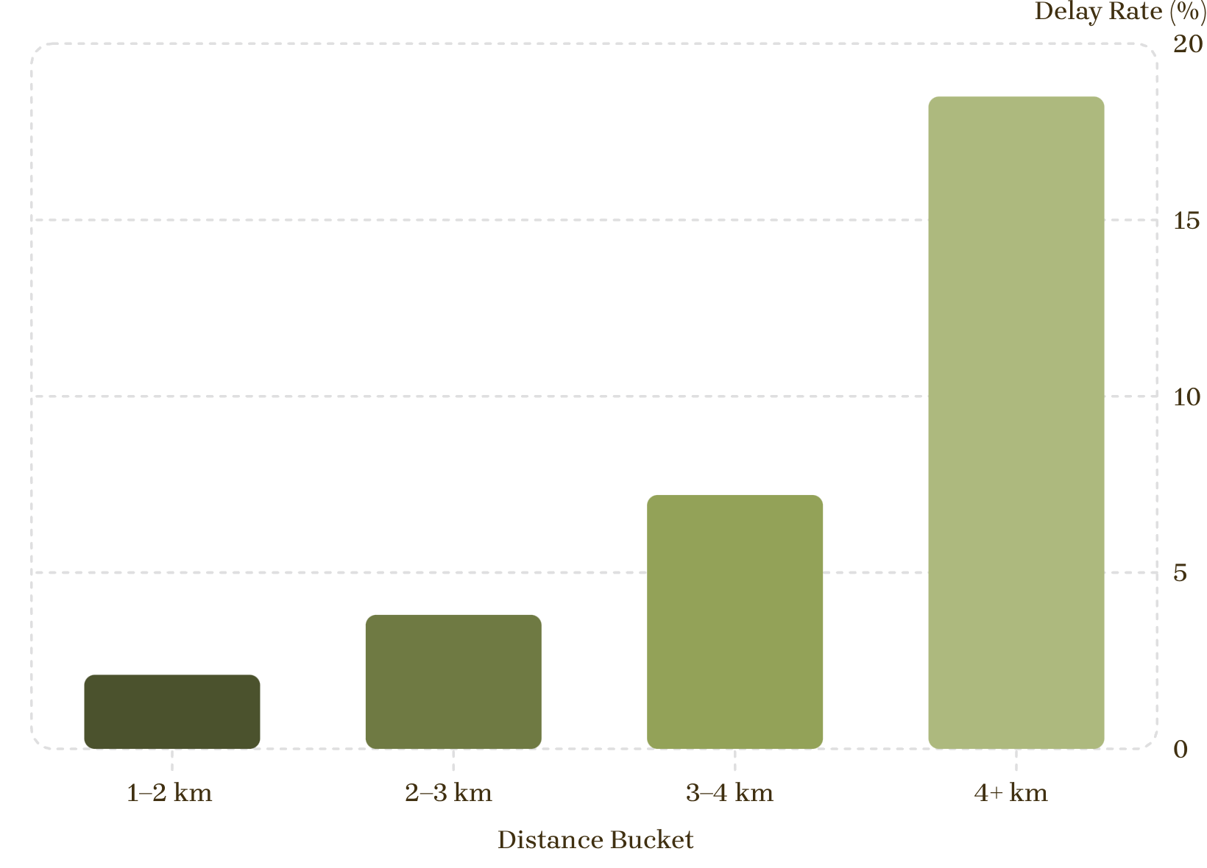

Delivery Distance vs. Delay Rate
The 4 km Tipping Point
Delay rates remain under 4% within a 3 km radius but spike sharply beyond 4 km. Average delay jumps from 3.2 minutes to 14.1 minutes — a 4.4× increase.
Recommendation: Cap dark-store fulfillment zones at 3.5 km for standard 15-min SLAs; auto-adjust fringe orders (3.5–5 km) to 30-min windows.

Slide 8
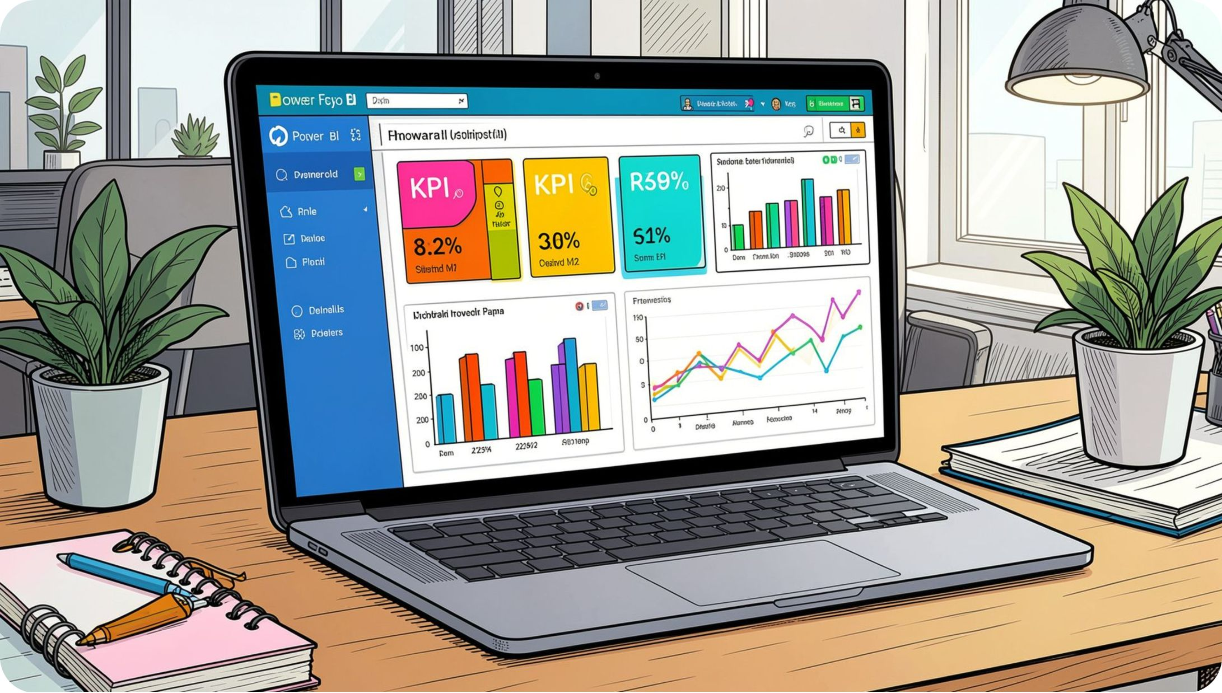
Power BI Dashboard Architecture
Star Schema Model
Fact Table: transformed_orders (revenue, order status, transactional metrics)
Dimension Tables (1-to-Many relationships):
transformed_customers — demographics & loyalty tiers
transformed_delivery — distance, fulfillment times, delays
transformed_feedback — ratings & feedback categories
transformed_inventory — stock levels & damage rates
transformed_marketing — ad spend & channel attribution
A custom Date Table powers time-intelligence DAX measures (MoM growth, YoY trends).

Slide 9
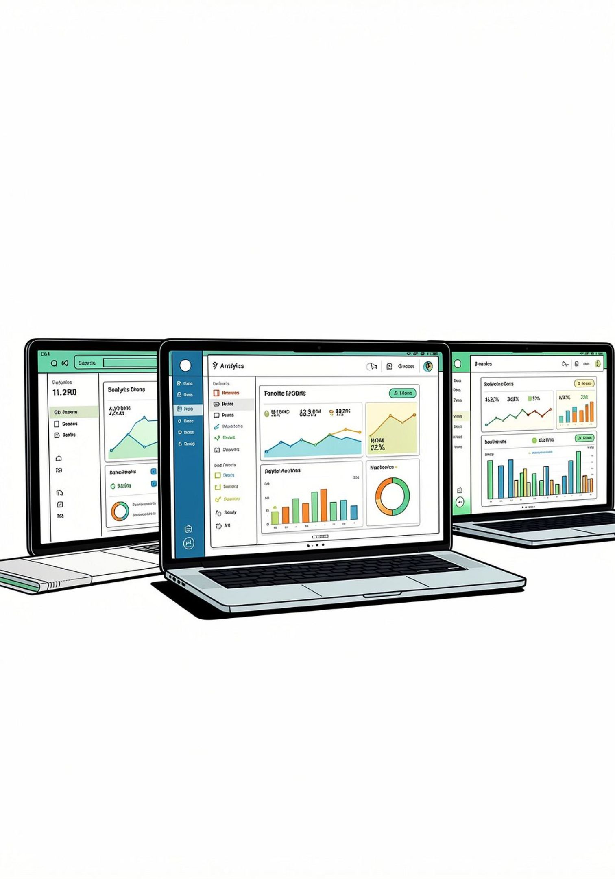
Dashboard Pages
Page 1: Executive Overview
Page 2: Operations & Fulfillment
Total Revenue, Orders, AOV, Delay Rate %. Revenue trends, category breakdown, and hub performance.
Avg Delivery Time, Delay (Mins), SLA Compliance, Damaged Inventory. Distance vs. delay matrix and stock loss charts.
Page 3: Customer & Marketing Insights
Avg Rating, Total Customers, Marketing Spend, ROAS. Rating vs. delay, RFM segmentation, and campaign ROAS funnel.

Slide 10
Business Recommendations & Conclusion
1
Optimize Dark Store Radii
2
Automate Delay Alerts
Cap delivery at 3.5 km for 15-min SLAs; auto-adjust fringe orders to 30-min windows.
Trigger in-app notifications with wallet credits at the 7-minute delay threshold.
3
Overhaul Cold-Chain Protocols
4
Reallocate Marketing Capital
Upgrade packaging for Fresh Produce & Dairy; shift to high-frequency daily deliveries.
Shift 25% of spend from broad Social Media to Search and Retargeting (4.2× ROAS).
This project delivered a complete ETL pipeline, relational database, and interactive Power BI dashboard — identifying the 4 km delay surge, 10-minute satisfaction drop, cold-chain vulnerabilities, and marketing inefficiencies with concrete, high-ROI recommendations.

